Slide 1

Cpsc1517
Blazor Introduction

Slide 2
Lesson Objective
By the end of this lesson, learners should be able to:
Overview of Blazor
Create a Blazor solution/project
Identify components of project
Add a page and menu item
Play with some html and css on page
Create a page to practice basic button events (may only get a start on this page)

Slide 3
Blazor Introduction
Blazor is a modern web user interface development technology developed by Microsoft. It allows for modern web application development, such as highly interactive single-page applications (SPAs).
What Technologies Does Blazor Use?
Blazor uses HTML, CSS and C# to create interactive client-side web user interfaces.
  HTML and CSS to describe the user interface.
  Blazor uses C# to implement the application behavior.

Slide 4
Using open standards means that without any plugin or extension, Blazor runs in every browser on every operating system.
There are four hosting models:
Blazor WebAssembly
Blazor Server
Blazor Hybrid
Blazor United

Slide 5
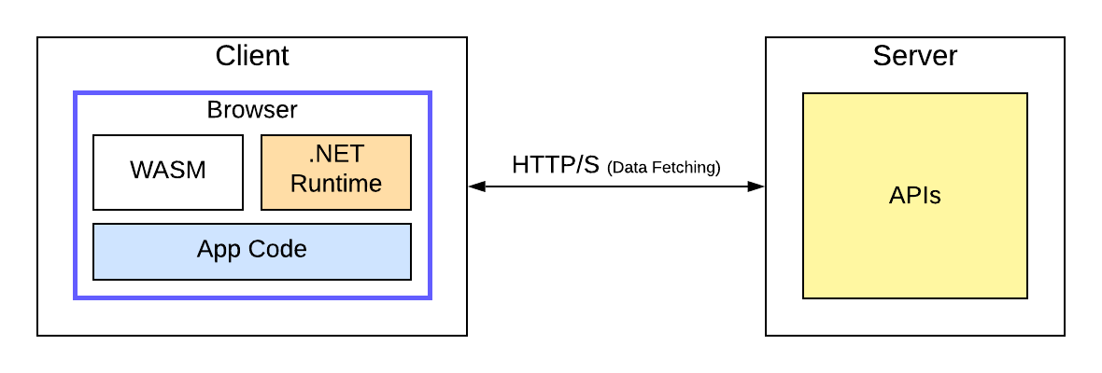
Blazor WebAssembly
Blazor WebAssembly is the most known model where the .NET code runs in the browser on WebAssembly, With the first request to the website, the browser downloads the application, including a .NET runtime. The application code is written in C#, and the .NET runtime translates the C# code into web assembly at runtime.
The advantage is that once downloaded, the whole application code is on the device, and execution based on web assembly can be done client-side. The client only connects to the backend to fetch additional data. This approach makes Blazor WebAssembly massively scalable.

Slide 6
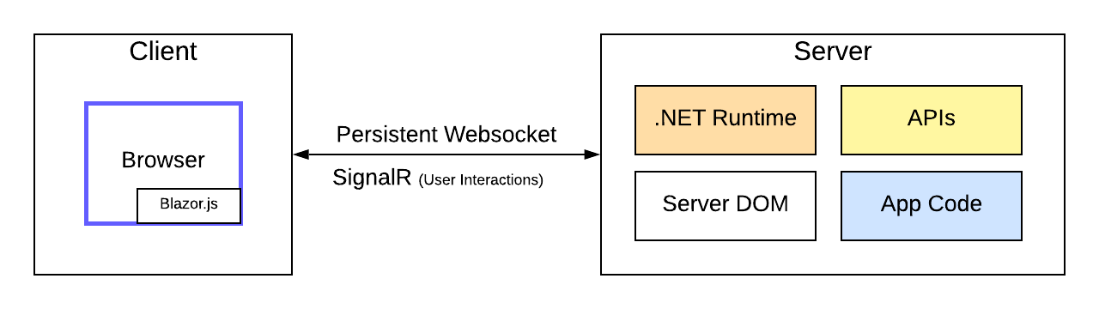
Blazor Server
The web app runs on the server, and the client connects using a SignalR (web socket) connection.
This approach requires a server capable of executing .NET code because the application runs on the server, usually in an ASP.NET Core web application. Scalability has its limitations because every client connects to the server using a persistent web socket connection using SignalR.
However, it has a faster download and initial page rendering because only HTML and CSS that appear on the screen are transferred from the server to the client. You also have full access to backend technologies because your code runs on the server.
Blazor Server is dependent on a stable network connection. Otherwise, you will experience latency issues.

Slide 7
What Model is Right for You?
For an internal application with a known number of users, I would use Blazor Server. I can code both the frontend and the backend code in the same project. The code runs in all browsers, even those not supporting web assembly.
For a customer-facing application with a scalable number of users, I would use Blazor WebAssembly. It forces me to implement a separate frontend and a backend, allowing me more control over security boundaries. I’m also able to scale up or scale out as needed. I save money on the infrastructure by offloading some of the work from the server to the client.

Slide 8
Razor Components
Blazor Server applications are built using Razor Components, which can also be called Blazor components. A component is simply a self-contained bit of functionality with logic that allows client-side interactivity using the Razor syntax and C# code. Razor components have 3 different render modes on the client.
ServerPrerendered: The component is rendered in HTML on the client and connects back to the server for interactivity.
Server: The component does not render in HTML on the client but connects back to the server for interactivity.
Static: The component is rendered in HTML on the client but does not connect back to the server for interactivity.

Slide 9
Data Binding
Data binding is a foundational feature of Blazor development used to bind data from the C# code to the user interface.
  one-way,
  two-way and
  event binding.

Slide 10
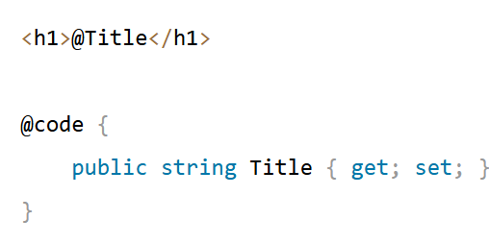
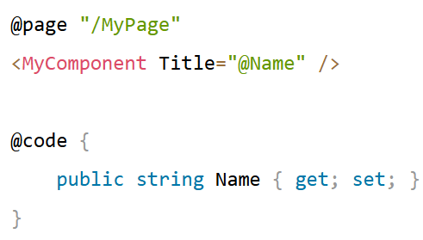
One-Way Binding—Property Binding
We want to use the Title property from the code section as the value for the heading.
Rendering data is very simple in Blazor. All we have to do is use the @ symbol followed by the property name or variable name.
Whenever the content of the Title property changes, the user interface will automatically be updated to reflect the new value.
We can use the same approach to provide the value of a property as an argument to a component parameter.
we render the MyComponent child component and provide the Name property as an argument for the Title parameter.

Slide 11
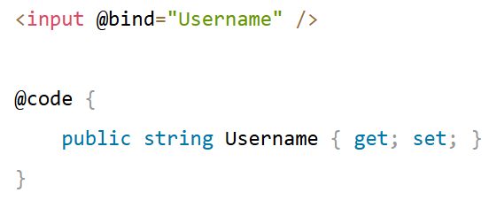
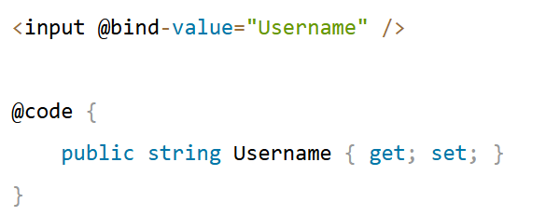
Two-Way Data Binding
data flows from the data model to the user interface and in the opposite direction.
That’s why it’s called two-way or bidirectional data binding.
we have an input field and bind the Username property
to the value property of the input element.
The spelling of the bind expression is important. For example, when using the pre-defined InputText component, we need to use an uppercase “V” for the Value property because the component exposes the Value parameter.
The rule of thumb I use is that the bindings usually need lowercase for standard HTML elements and uppercase for Blazor components.

